Slide 1
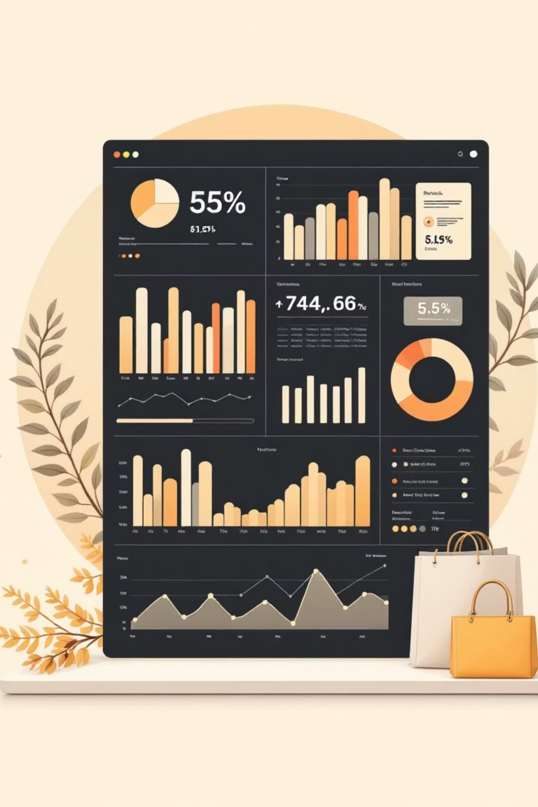
Customer Shopping Behavior Analysis
Uncovering actionable insights from 3,900 customer purchases to drive data-informed marketing strategies and revenue optimization

